Slide 1
Baseline models

Slide 2
Different baseline models:
Copy past
Markovian
Non-markovian

Slide 3

Copy past
Quick and easy:
No learning needed
Just consider the system as static:
$$\vec{y_{t}}=\vec{y_{t−1}}$$

Slide 4

Markovian
Consider that all the information needed is in the last time point
Quick learning needed
$$\vec{y_{t}}=A\vec{x_{t−1}}$$

Slide 5

Non-Markovian
Consider that all the information needed is not in the last time point
Longer learning needed
$$\vec{y_{t}}=\sum_{Δ=1}^{Δ=m}{A_{Δ}\vec{x_{t−Δ}}}$$

Slide 6


Non-Markovian (In practice)
Each target is fit separately
To determine the value of delta:
Compute the cross-correlation of y with all the input variables
Set a threshold over this value (eg: 0.2 or 0.5) and a maximum window to remove the periodic characteristics
Set $x_{i}$ to 0 for all variables that do not reach the threshold
$$y_{i,t} =\sum_{Δ=1}^{Δ=m}{A_{iΔ}\vec{x_{t−Δ}}}$$

Slide 7
LSTM
Use a long-short term memory neural network with the following parameters:
2 Layers
0.3 dropout probability
0.01 l2-weight
Mean squared error loss
150 hidden dimensions at each layer
A 15 days context (with a new data each hour)
Time2Vec time encoding

Slide 8
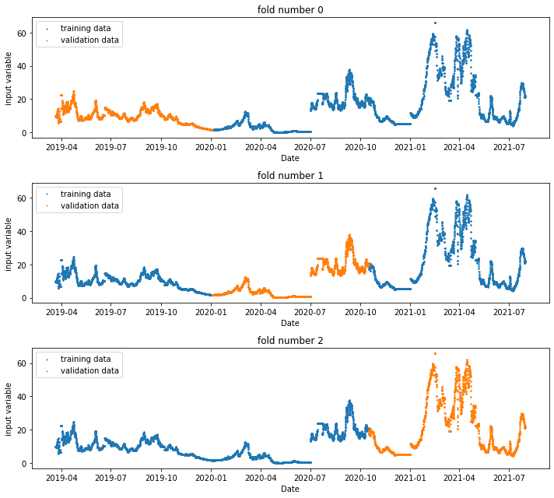
K-fold cross-validation
Example of 3-fold cross-validation

Slide 9
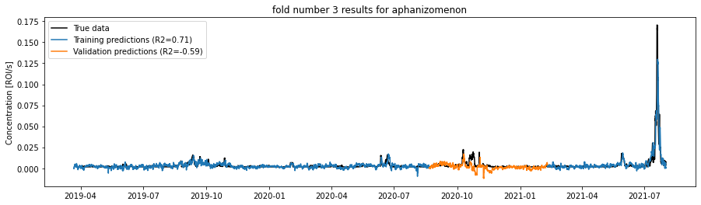
Why K-fold?
The training data is not representative of the behavior of the model on unseen events: The forecasting score always deteriorate

Slide 10
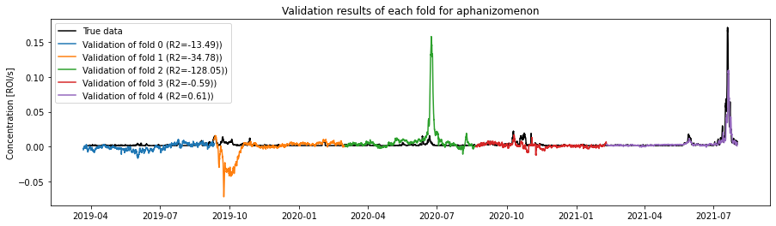
Why k-fold
Allows to use the whole dataset as validation once
Give a better statistical sense of model performance
Con: Does not show if any shift in dataset are present

Slide 11
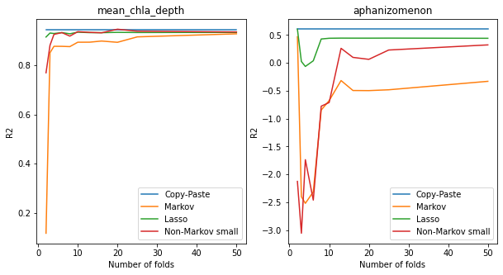
Why k-fold
Allows to use more data for training:
When data is limited, allows to use most of it to training while keeping a statistically relevant validation

Slide 12
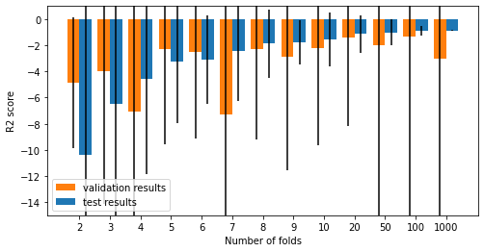
Assumption necessary
The distribution is time independent:
The dynamics driving the planktons are not drastically changing over the years
Effects of climate change are negligible
Note that some folds are more difficults than other to fit, causing the variance of the validation results to be high.

Slide 13
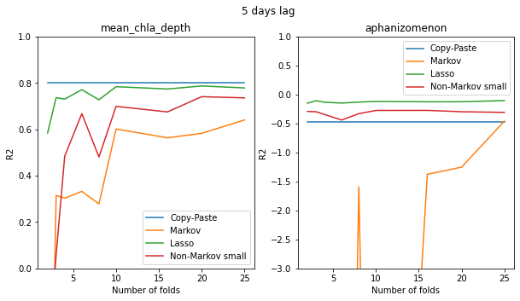
Influence of the number of folds on different models

Slide 14
About the plots
Intuitively, the similarity of the true data and prediction is seen as the shortest distance between the two curves
True data
Prediction
Intuitive error

Slide 15
About the plots
In forecasting however, only the vertical error is important
True data
Prediction
True error
Several published paper have used this trick without acknowledging it

Slide 16
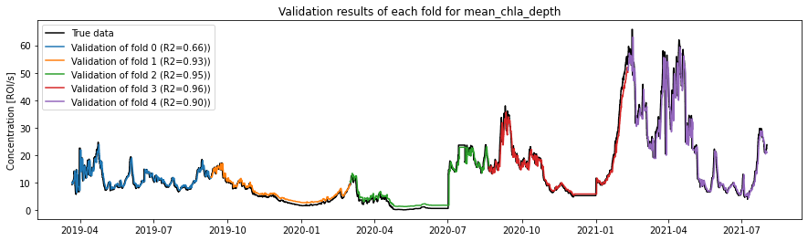
Example:
The fit in fold 0 (blue) is way worse than the one of fold 2 (green)

Slide 17
Summary:
After a lag of 5 days, the models have the following r2 (trained with all the 100 variables):
Model | Variable | Median R2 | std | Worst case
Copy-paste | Chlorophyll a | 0.78 | 0.35 | -0.15
 | Aphanizomenon | 0.31 | 0.7 | -1.23
Markov Linear | Chlorophyll a | 0.38 | 1.05 | -2.76
 | Aphanizomenon | -1.86 | 556 | -1860
Markov Lasso | Chlorophyll a | 0.75 | 0.27 | 0.03
 | Aphanizomenon | -0.61 | 3.14 | -10.27
Non-Markov | Chlorophyll a | 0.63 | 0.42 | -0.21
 | Aphanizomenon | -1.3 | 4.43 | -14.46
Random forest | Chlorophyll a | 0.68 | 0.62 | -1.25
 | Aphanizomenon | -0.84 | 15.05 | -5064

Slide 18
Summary:
After a lag of 5 days, the models have the following r2 (trained on a small subset of 14 variables):
Model | Variable | Median R2 | std | Worst case
Copy-paste | Chlorophyll a | 0.78 | 0.35 | -0.15
 | Aphanizomenon | 0.31 | 0.7 | -1.23
Markov Linear | Chlorophyll a | 0.70 | 0.33 | -0.18
 | Aphanizomenon | -0.32 | 1.12 | -3.17
Markov Lasso | Chlorophyll a | 0.75 | 0.27 | 0.03
 | Aphanizomenon | 0.07 | 0.25 | -0.26
Non-Markov | Chlorophyll a | 0.74 | 0.31 | -0.14
 | Aphanizomenon | -0.03 | 0 | -0.03
Random forest | Chlorophyll a | 0.61 | 0.58 | -0.87
 | Aphanizomenon | 0.05 | 8.8 | -29.45

Slide 19
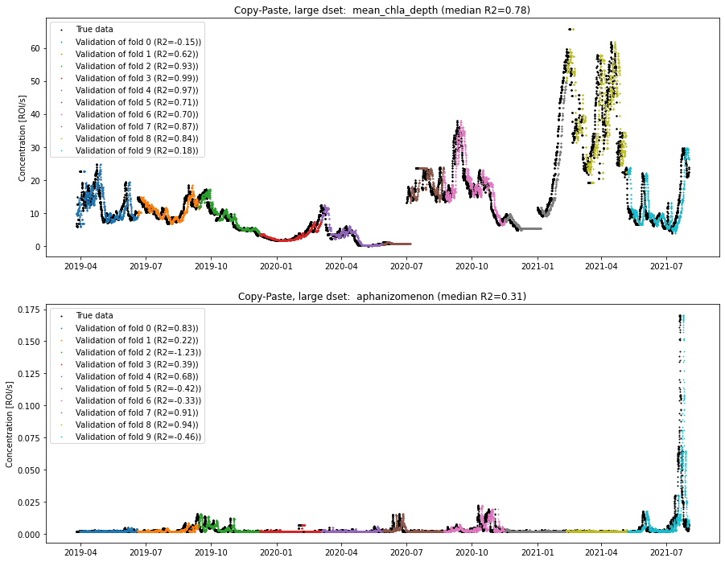
Copy paste (lag = 5 days)

Slide 20
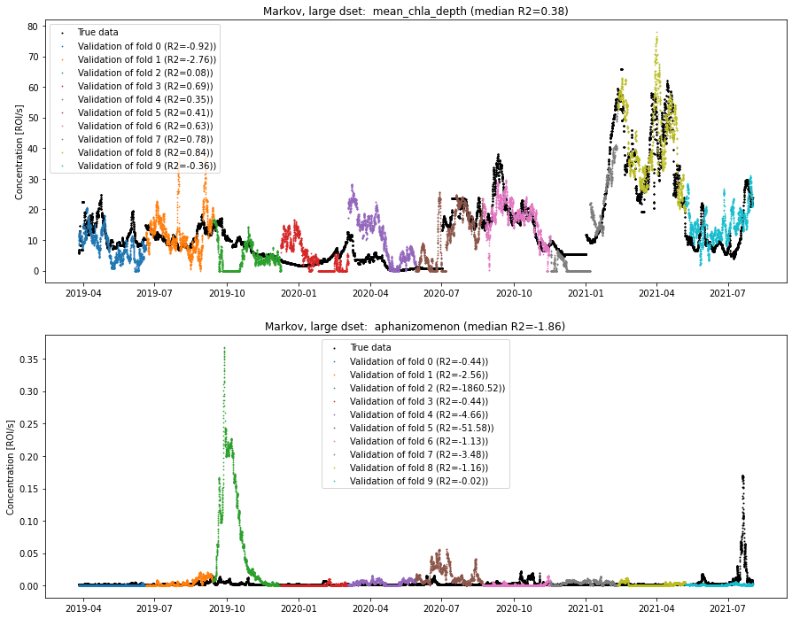
Markov linear(lag = 5 days)

Slide 21
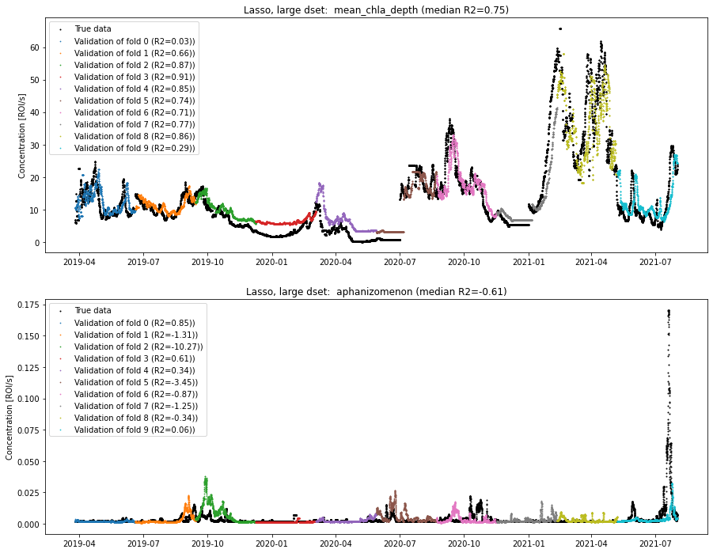
Markov lasso(lag = 5 days)

Slide 22
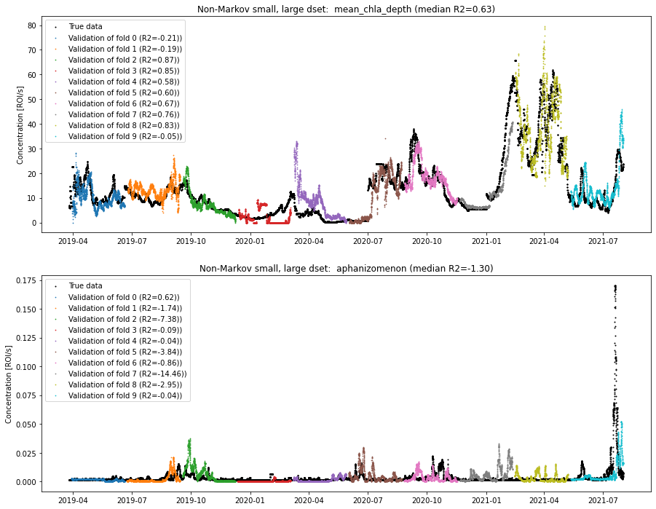
Non-Markov (lag = 5 days)

Slide 23
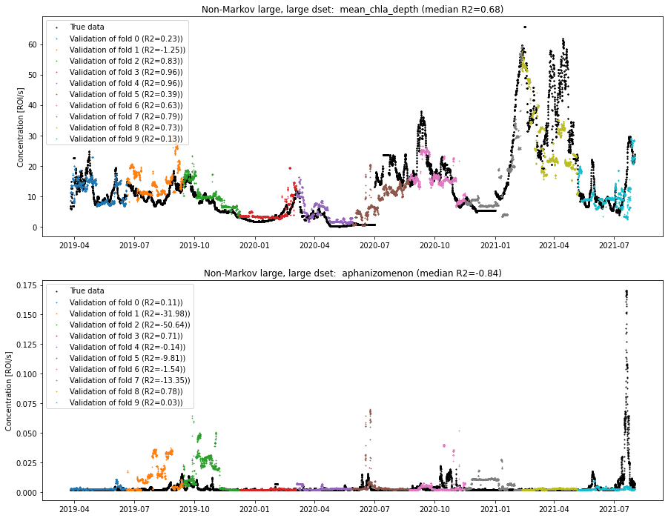
Random forest (lag = 5 days)
Sorry for the misleading name, the random forest are markovian

Slide 24
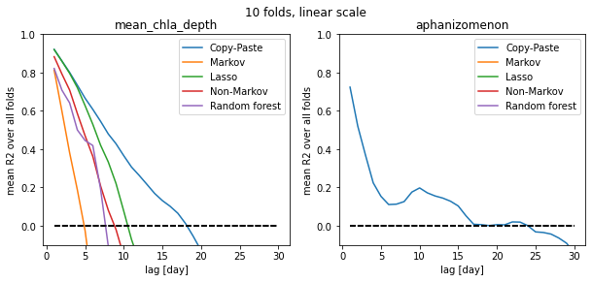
Full dset, linear

Slide 25
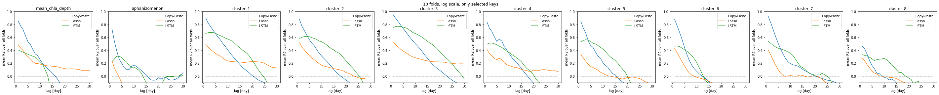
Small dset, log scale

Slide 26
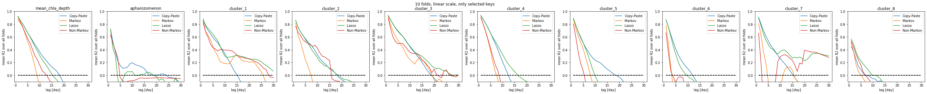
Small dset, linear

Slide 27

Copy paste (lag = 5 days)

Slide 28
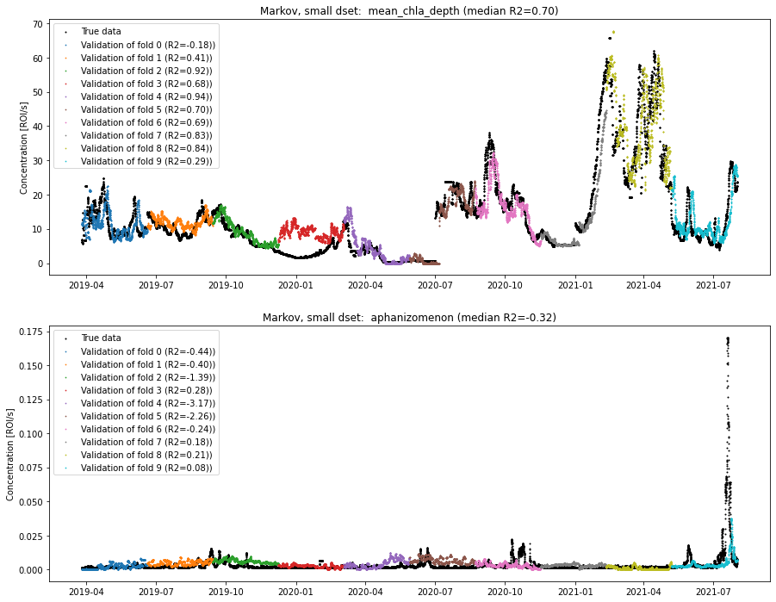
Markov linear(lag = 5 days)

Slide 29
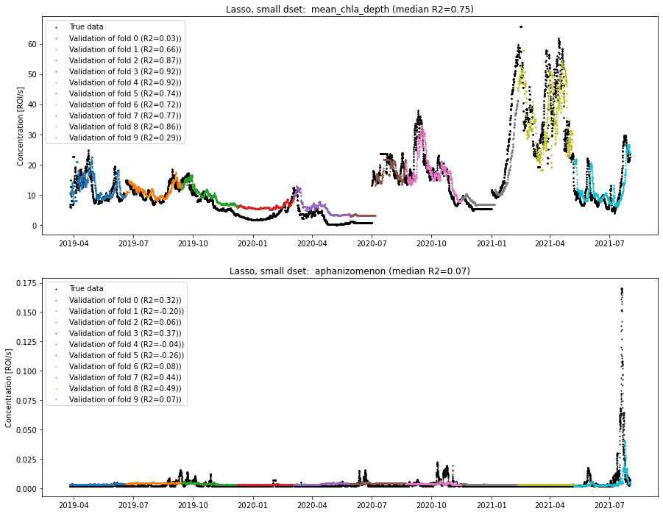
Markov lasso(lag = 5 days)

Slide 30
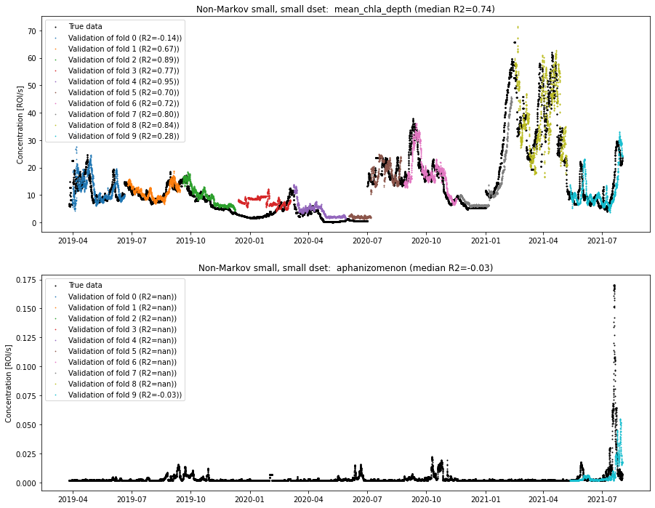
Non-Markov (lag = 5 days)

Slide 31
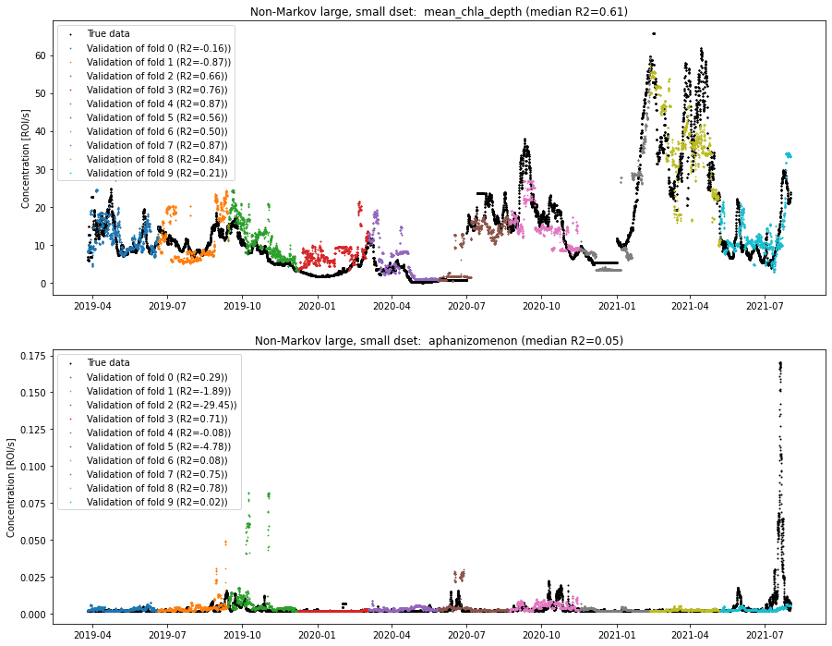
Random forest (lag = 5 days)
Sorry for the misleading name, the random forest are markovian

Slide 32
Copy paste (lag = 5 days)

Slide 33
Markov linear(lag = 5 days)

Slide 34
Markov lasso(lag = 5 days)

Slide 35
Non-Markov (lag = 5 days)

Slide 36
Random forest (lag = 5 days)
Sorry for the misleading name, the random forest are markovian

Slide 37
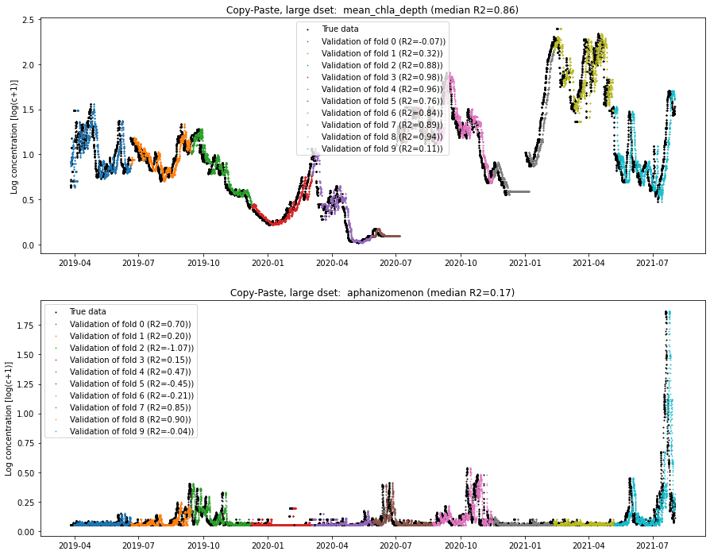
Copy paste (lag = 5 days)

Slide 38
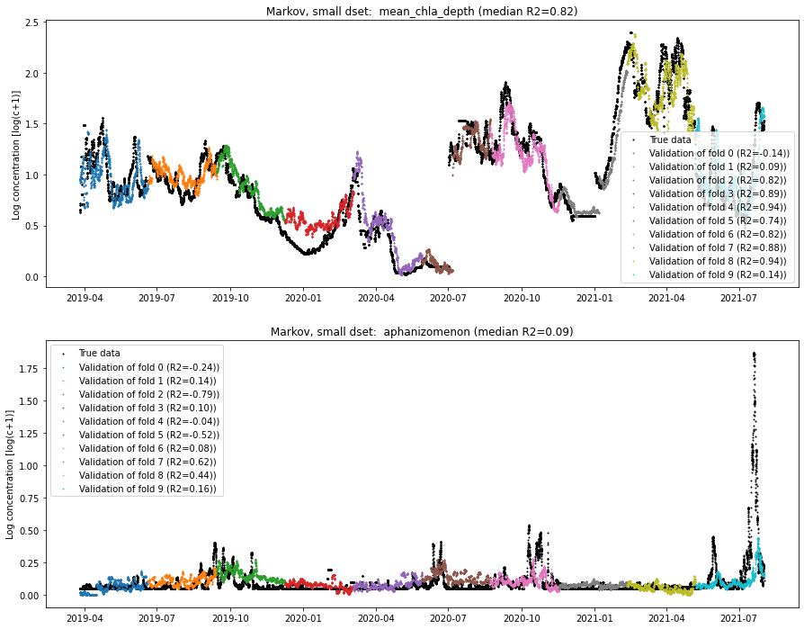
Markov linear(lag = 5 days)

Slide 39
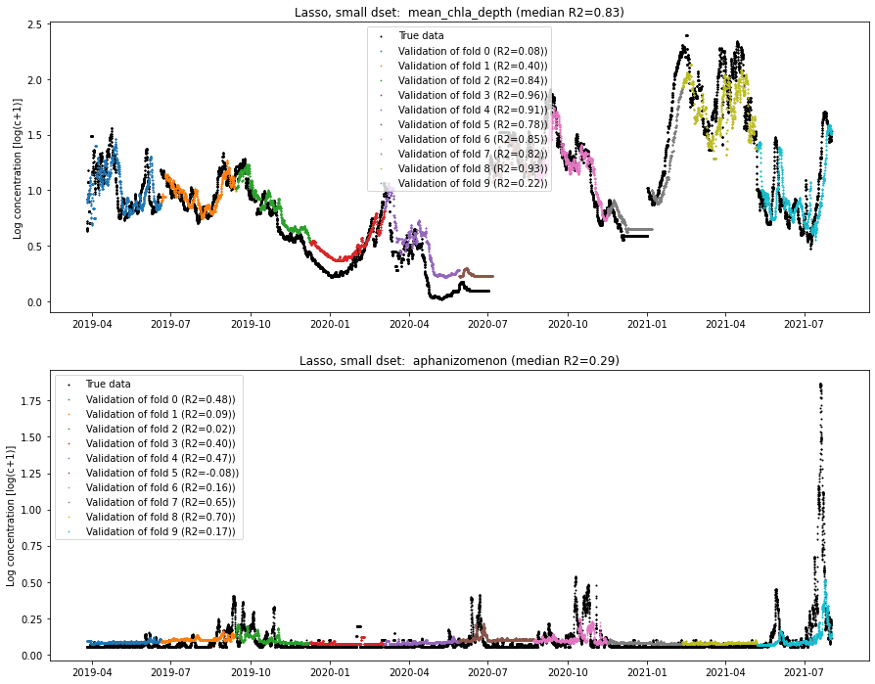
Markov lasso(lag = 5 days)

Slide 40
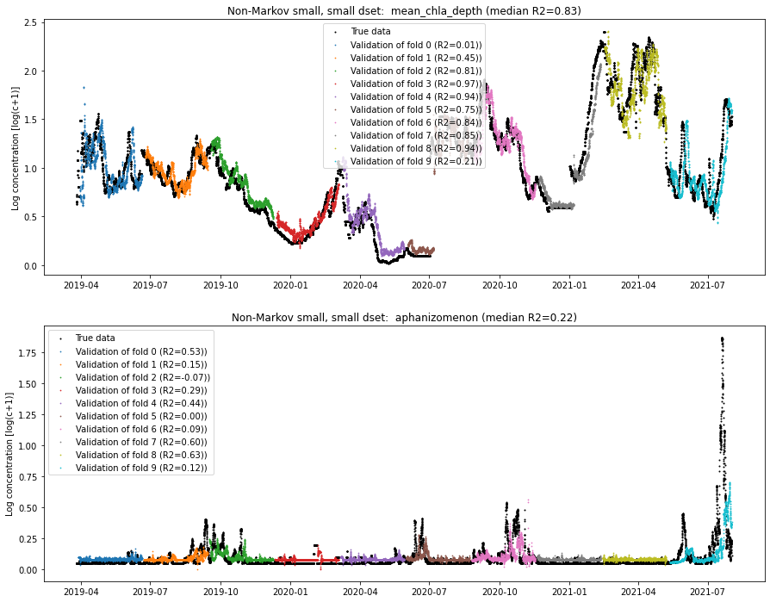
Non-Markov (lag = 5 days)

Slide 41
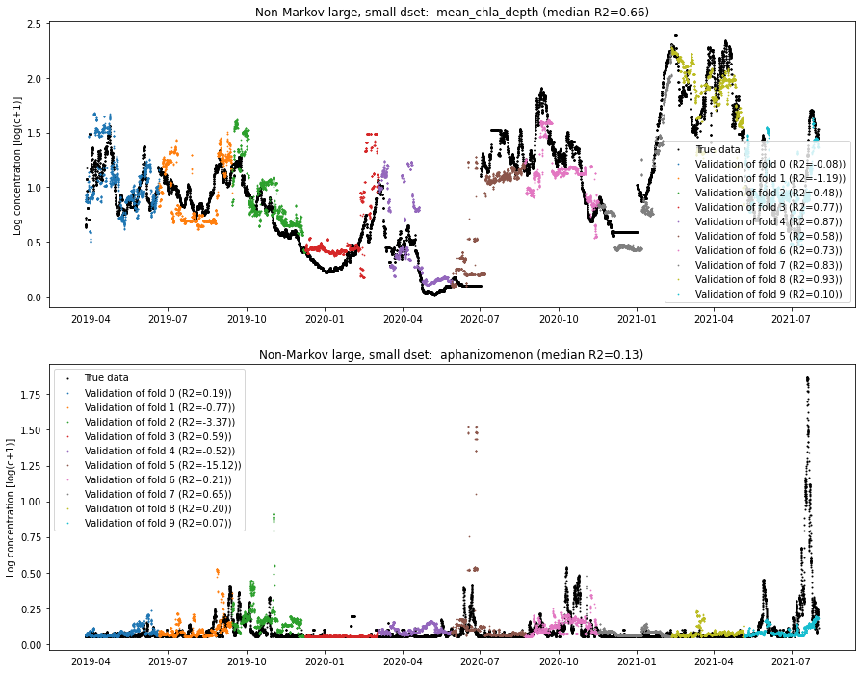
Random forest (lag = 5 days)
Sorry for the misleading name, the random forest are markovian

Slide 42
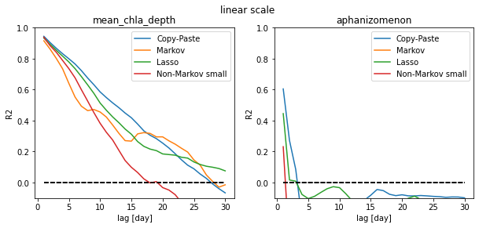
All models on linear scale and all keys:

Slide 43
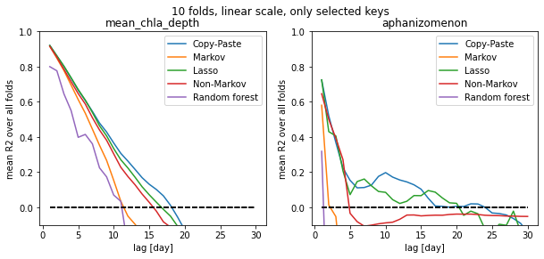
All models on linear scale and selected keys

Slide 44
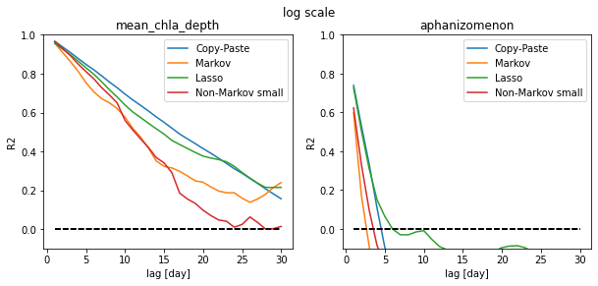
All models on log scale:

Slide 45
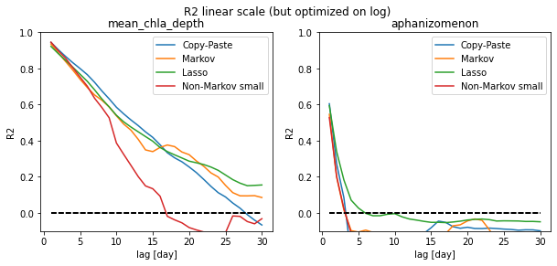
R2 linear but log-trained
The fact that the results are better than with the linear scale signifies that the driving factors are effectively better explained by exponentials than linear relations

Slide 46
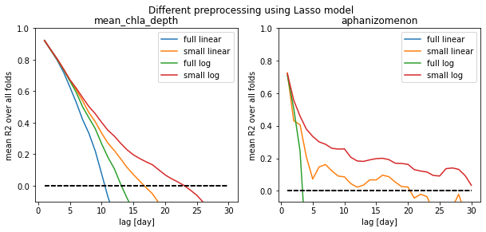
Only shown for Lasso

